Slide 1

We’ll get started soon! While you wait, pull up the site and try a transcription!
Notes:
Pull up this slide while your participants are arriving. If you’re focusing on a specific person or campaign, you could add an image of them here.

Slide 2
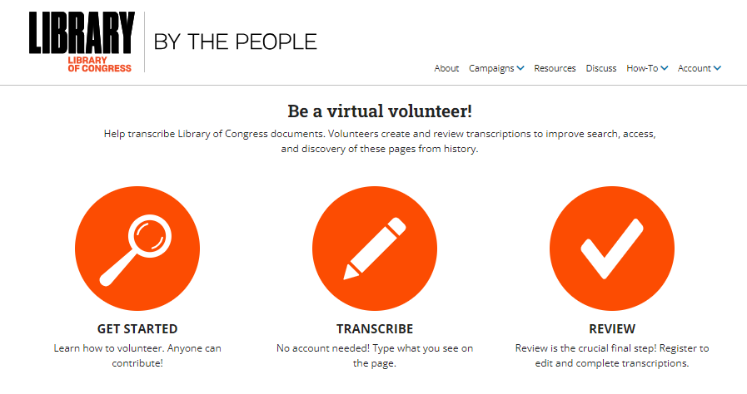
Welcome to the Transcribe-a-thon!
Notes:
Add the specific title of your event and name(s) of your hosts here

Slide 3
Today’s Agenda
What is By the People?
How to contribute
Let’s try it!
Notes:
Introduce the event and what you’ll be doing. This is a good time to find out how many people have transcribed before!

Slide 4
What is By the People?
A website that invites you to contribute to public knowledge by transcribing Library of Congress digital collections.
Why join in?
Discovery – Enable page-level keyword search
Accessibility – Make pages easier to read for all people
Datafication – Open text to computational research and analysis
Personal development – Learn & connect to history
Service – Help the Library of Congress achieve these goals!
Notes:
Transcriptions improve discovery within collections by enabling keyword search at the page level.
Transcriptions also aid accessibility. They make it easier for everyone to read handwritten, blurry, or dense documents. They also create text can be used by screen readers and other accessibility tools.
Transcriptions also turn the documents’ text into data that can power computational research. Researchers can use the transcriptions in bulk for projects like digital mapping of locations, human relationships, or sentiments within or across collections.
By the People’s impact on the collections can’t be disentangled from the impact on volunteers. Volunteers gain skills and experience in important forms of historical literacy, including research and analysis. Transcribing also creates connection to the history and people in these pages.

Slide 5
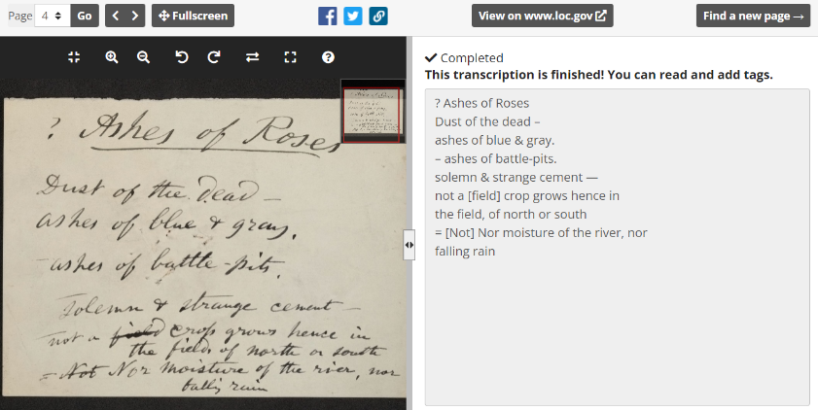
Volunteers transcribe and review
Notes:
How does it work? Volunteers transcribe pages using the transcription interface. An image of a selected page is shown on the left and you type (or review) text in the box on the right.
Here’s an example showing a draft of the Walt Whitman poem, Ashes of Roses
Transcriptions are completed through a consensus-based model. All text is created and reviewed by volunteers. Anyone can transcribe without creating an account. Only registered volunteers can review other people’s transcriptions or add tags. Registers users also have a profile where they can track their contributions.
Completing a page requires at least 2 volunteers – one to transcribe something and then another to review it. If it looks good, they mark it complete; if they find an error, they can correct it and submit it for another round of volunteer review. A more complicated transcription could take many more passes back and forth through review.
Everyone is welcome to give it a try and do their best. The safety net of review allows you to give it a go, make mistakes, and learn from them!

Slide 6
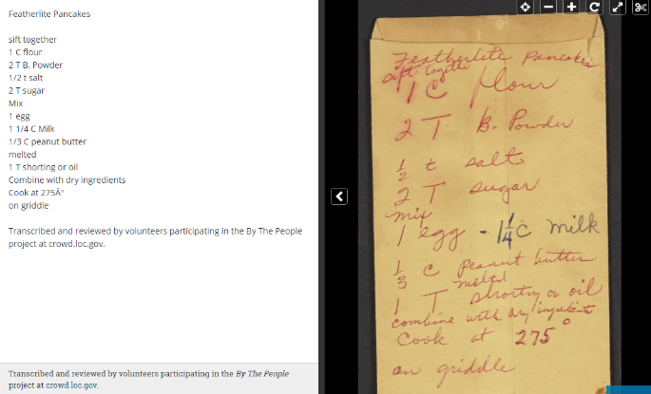
Completed transcriptions are published on loc.gov
Notes:
After transcriptions are complete, the Library of Congress adds the text to the digital collections on loc.gov. Once published there, they enhance search and discovery.
This is one example of a completed transcription – Rosa Parks’ pancake recipe. Now that it has a transcription, when you search “peanut butter” in loc.gov you will get to this item (it’s her secret ingredient). This is a fun example, but you can also imagine what that does for the names and places within her archives and the other collections transcribed.
You can also see here that volunteers are credited at the bottom of every transcription.

Slide 7
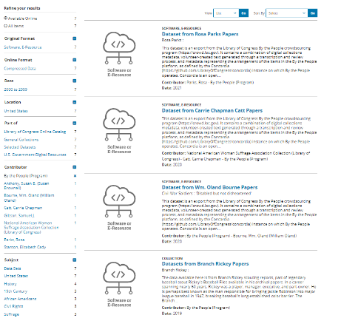
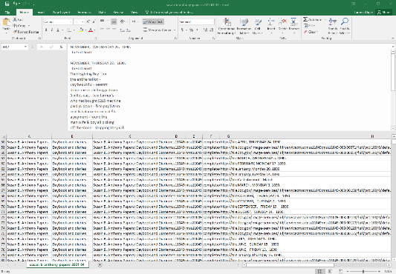
And packaged as datasets
Notes:
In addition, the Library of Congress also releases datasets of completed campaigns so researchers can work with the transcriptions in bulk for computational research, building a map of places or a diagram of people and relationships within the collection, for example.

Slide 8
Today’s activity
Tell participants what you’ll be working on and why
Add an image from the collection!
Notes:
This is a good time to talk about the topic of your transcribe-a-thon if there is one. Here is an example slide for Mary Church Terrell. You can transition to your topic from the concept of searchable/accessible text by talking about what information might be surfaced through its transcription.

Slide 9

Let’s try it!
Notes:
Demonstrate how to navigate and contribute to the site. The image above is hyperlinked. Important functionality to show:
Where to register or log in
Finding something to work on:
Jump into activity from the homepage
Or choose something to work on by browsing active campaigns
Filter to find items not yet started, in progress, or in need of review
Transcription interface
Where to find quick tips or navigate to full instructions
How to save and submit a transcription
How to review an item – either by accepting as complete or making edits
Show what data is captured on the profile page

Slide 10
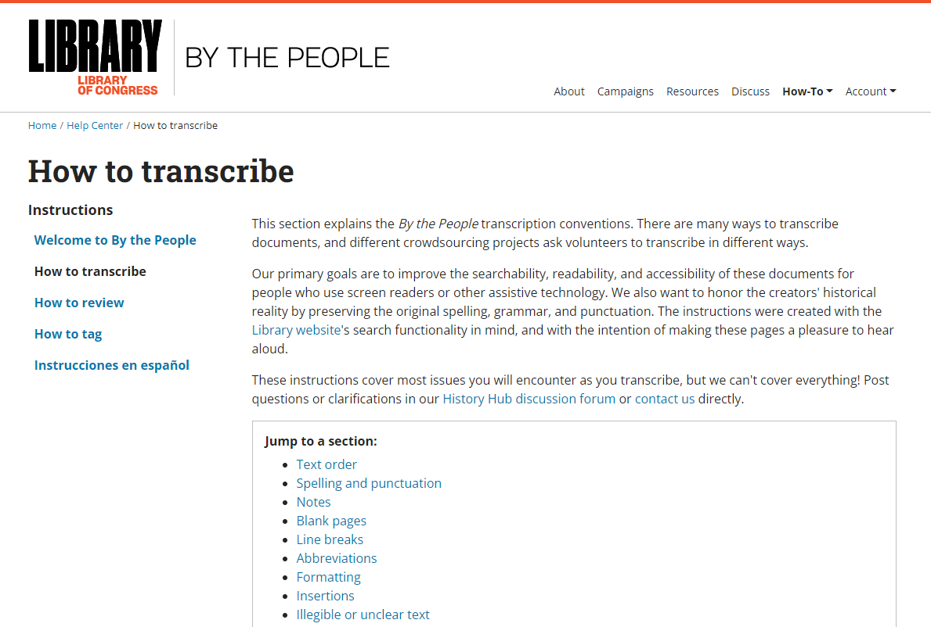
Notes:
Now we are quickly going to go over instructions for how to transcribe By the People.
Search and readability are our primary goals. Both are useful to keep in mind as you encounter questions about how and what on the page should be captured in a transcription.
You can view detailed instructions for transcription, review, and tagging at any time by clicking How-To in the top right of any page. The site tries to give clear guidance for the most common issues you’ll encounter in the text. However, we can’t cover everything. There will always be gray areas where you will have to navigate using your best judgement. That’s ok! You’re in a safe space to ask questions and work together to find solutions. The review process also means that you aren’t making choices in a vacuum. Your fellow volunteers are there to check your contributions and make edits as needed.
Right now walk through basic instructions addressing some of the most common issues you’ll encounter.

Slide 11
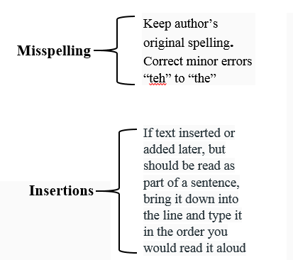

Transcription style guide
For misspellings of names or other significant “keywords” – use tags to add the correct term to the item.

Slide 12
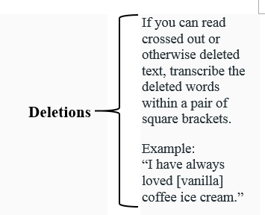

Transcription style guide

Slide 13
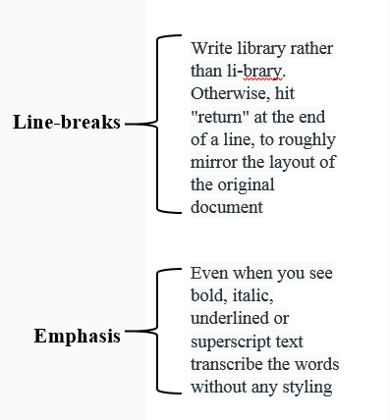
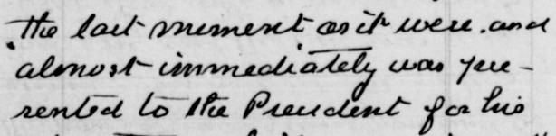

Transcription style guide

Slide 14
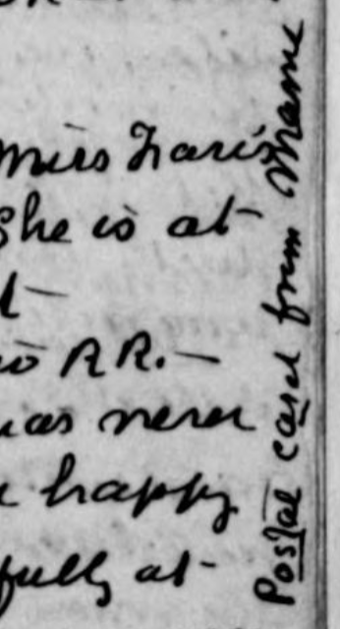
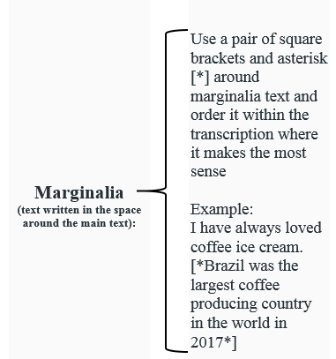
Transcription style guide

Slide 15
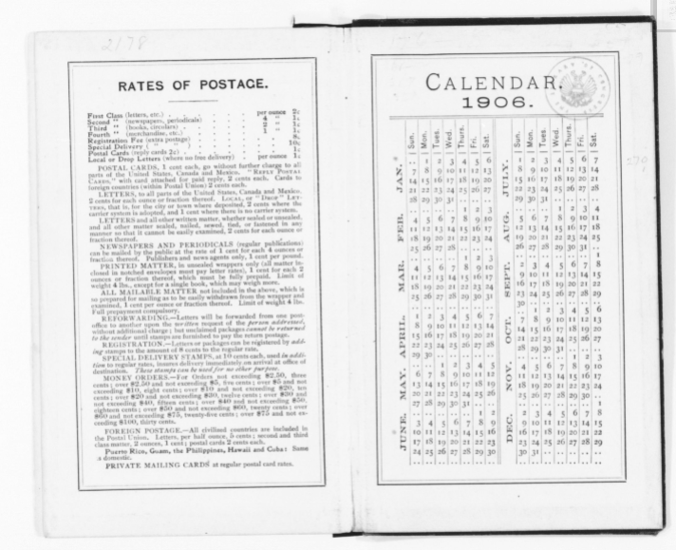
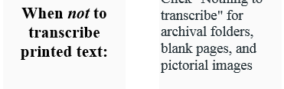
Transcription style guide
Click “Nothing to transcribe” for blank pages and template printed pages

Slide 16
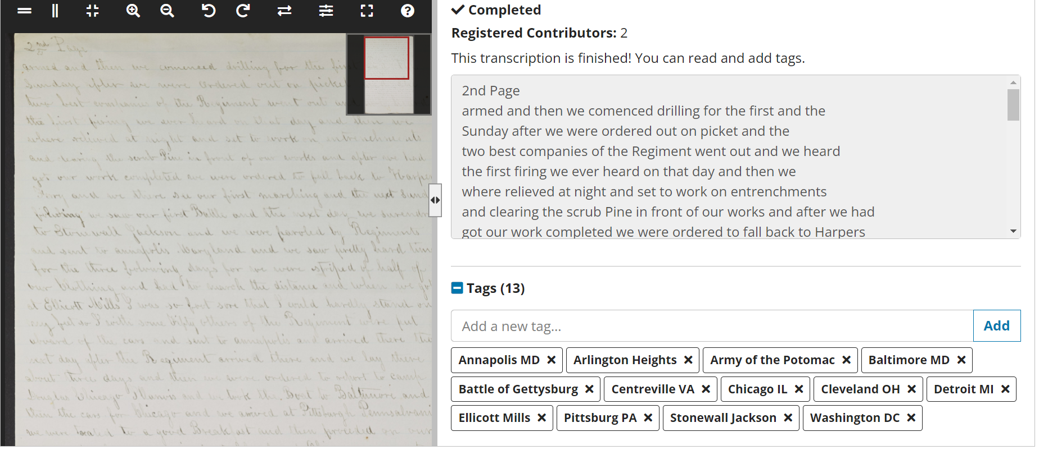
What about tags?
Notes:
Tags are not returned to loc.gov for search. Think of tagging as a tool to help other volunteers understand and navigate pages within the site. Tags can be used to add additional context, such as full names, correct spellings of terms misspelled in the original document, or information about the document such as the language it’s in or unique features like photos or illustrations
Adding tags can be helpful for reviewers and other volunteers, but it also isn’t the most impactful form of contribution in most cases. We recommend it as a secondary activity to transcription.

Slide 17
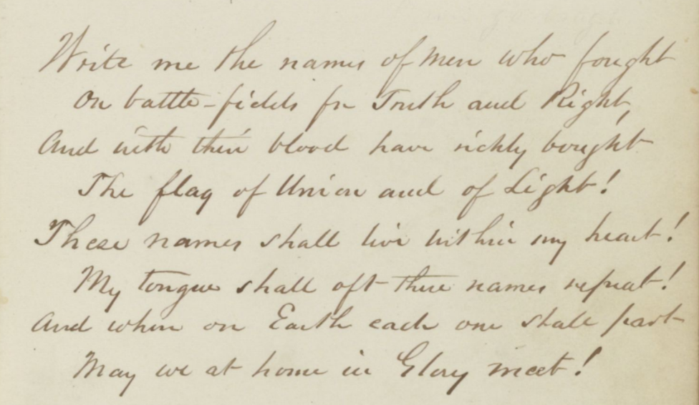
Let’s jump in!
https://crowd.loc.gov
Notes:
Time to try it out!
Check out our Transcribe-a-thon instructions for ideas of large and small group activities to try out before having the participants strike out on their own.

Slide 18
Thank you for coming!
History Hub Discussion Forum:
historyhub.history.gov/
community/crowd-loc
Email:
Crowd@ask.loc.gov
Twitter:
@Crowd_LOC
Newsletter: sign up at bottom of any By the People page
Stay connected and involved with By the People:
Notes:
You did it - great work! Don’t forget to send us a summary of your event and any feedback you have!

